Slide 1
Funding Your Education
Understanding Financial Aid
Presented by Rocket Solution Central

Slide 2
Presentation Overview
How to Apply – Snapshot of the FAFSA
Parent Information
Types of Aid
Next Steps

Slide 3
FREE Application for Federal Student Aid (FAFSA)

Slide 4
Complete FAFSA Each Year! www.studentaid.gov/FAFSA
2026-2027 Aid Year
Application available October 1
Use 2024 tax information
Terms of eligibility include: Summer 2026, Fall 2026, and Spring 2027
FSA ID
All contributors will need their own FSA ID (parent(s) and student)
Username and password created by contributor
Used to access and sign Federal Student Aid forms: FAFSA, Master Promissory Note, Parent PLUS Loan, etc
** Schools receive student’s FAFSA results approximately 3-5 business days after student submits to the U. S. Department of Education. **

Slide 5
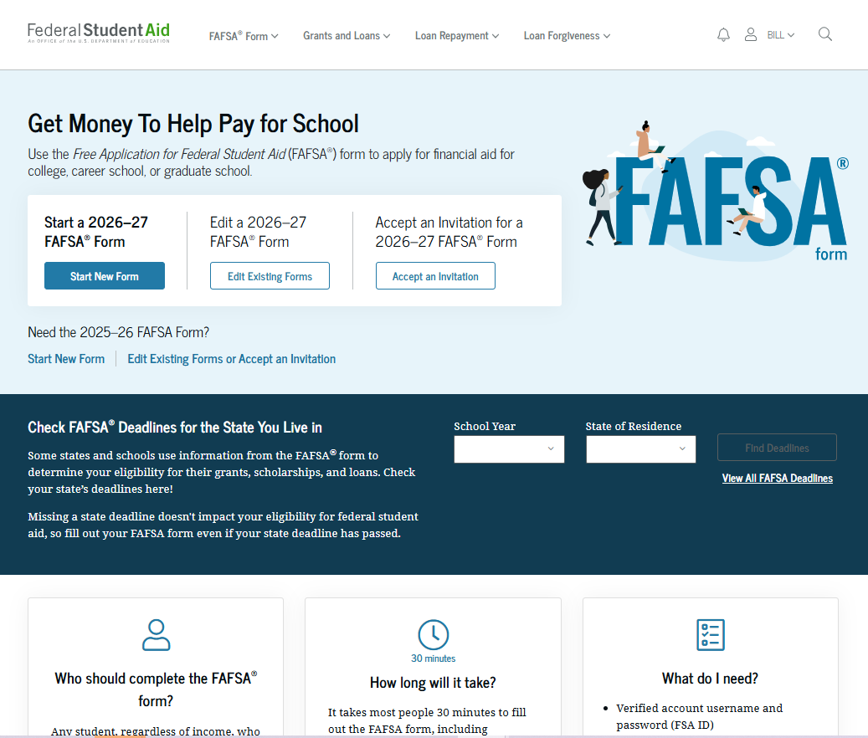
FAFSA Landing Page

Slide 6
FAFSA Sections
Both student and parent(s) will have a series of ‘Onboarding’ pages and will be required to acknowledge their ‘Consent’ for the FAFSA to retrieve their IRS data.
Student
Parent(s)
Personal Circumstances
Determines the student’s dependency status
Demographics
Financials
Colleges
Invites Parent
Signature
Demographics
Financials
Signature

Slide 7
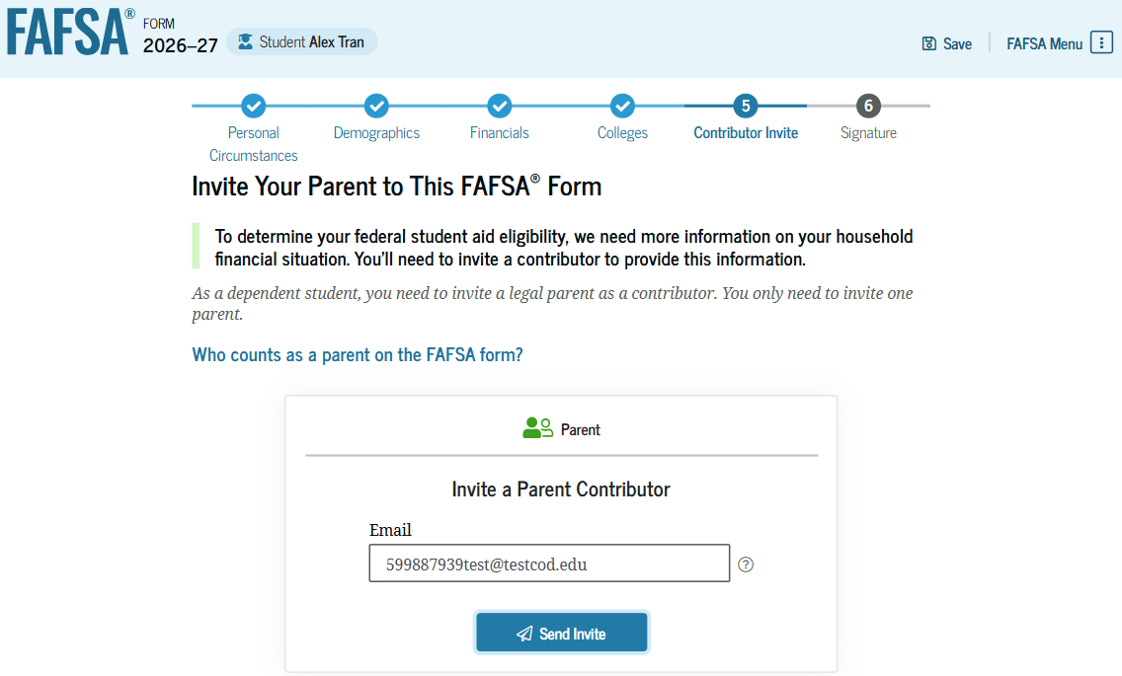
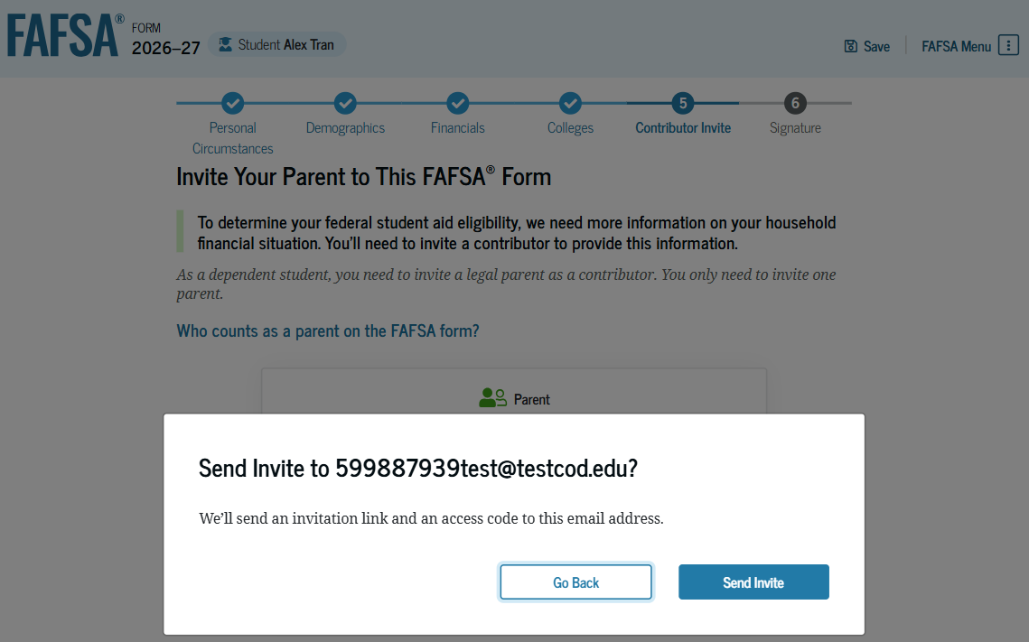
Student Invites Parent to FAFSA
The student is asked to enter their parent’s email address to invite the parent to the FAFSA® form. After entering the email address, the student selects "Send Invite." A pop-up window appears, and the student confirms their parent’s email address by selecting "Send Invite."

Slide 8
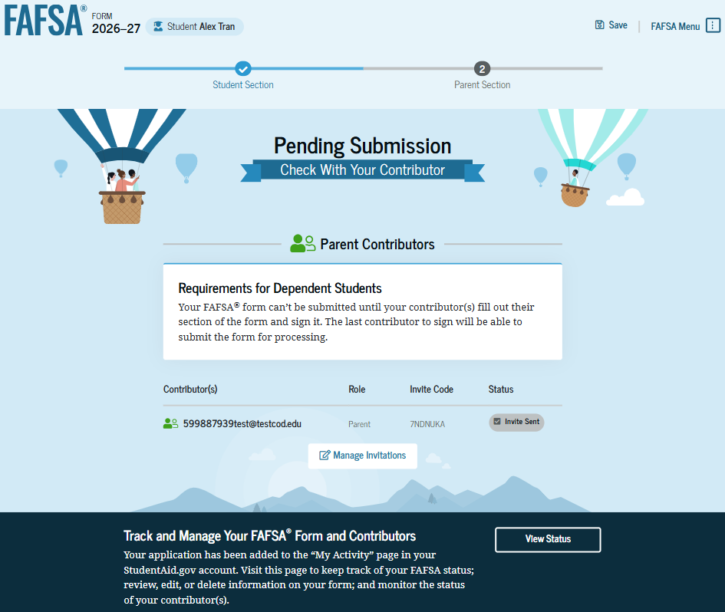
Dependent Student Section Complete

Slide 9
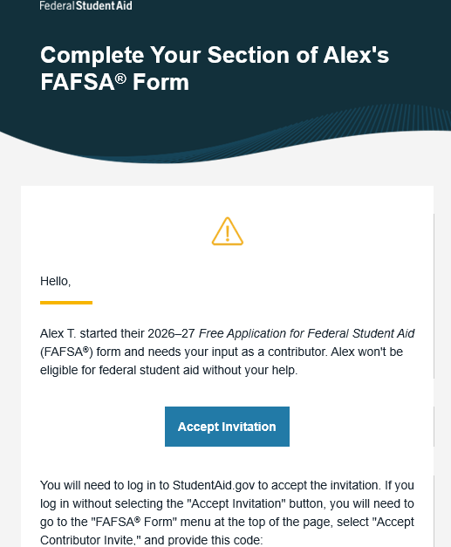
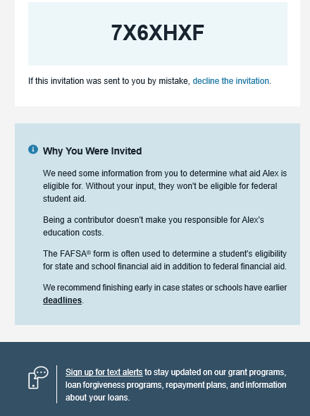
Parent’s Invite to FAFSA
This is NOT a view within StudentAid.gov or the FAFSA® form. This view demonstrates a parent opening the FAFSA invitation from their email. The parent selects "Accept Invitation" and is taken to StudentAid.gov.

Slide 10
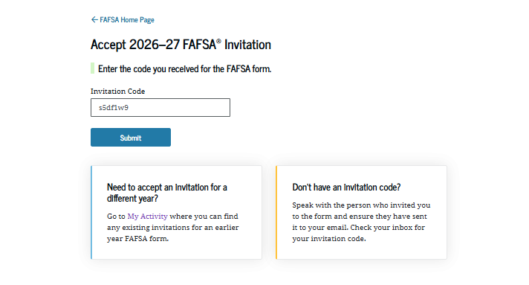
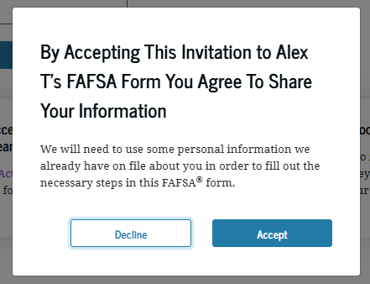
Parent Accepts Invitation
After logging in, the parent is taken to the "Accept 2026–27 FAFSA® Invitation" page. The invitation code from the parent’s email automatically fills in the text box if the parent used the link from the email.
When the parent selects "Submit," a pop-up window appears, confirming the student’s name and reminding the parent that their personal information is needed to fill out the student’s FAFSA® form. The parent selects "Accept" to agree to sharing their information and enters the FAFSA form.

Slide 11
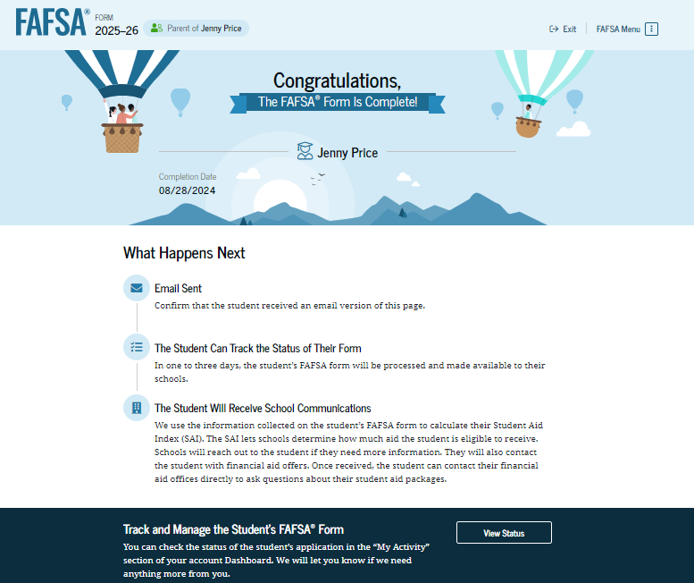
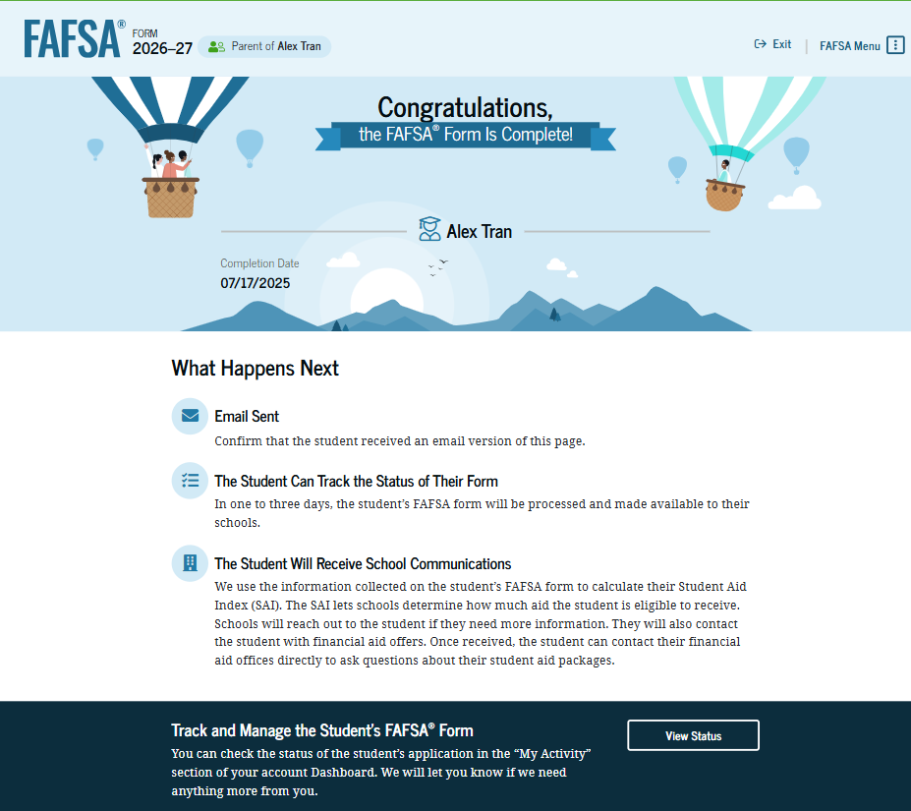
Completed FAFSA Confirmation

Slide 12
Parent Information

Slide 13
Is Parent’s Information Required?
Yes, unless the student meets one of the following:
Born before January 1, 2003.
Married.
Working on master’s or doctorate program.
Currently serving on active duty in the U.S. armed forces for purposes other than training.
Veteran of the U.S. armed forces.
Provide more than 50% of financial support to children or other people (excluding your spouse) who live with you.
At any time since you turned age 13 were an orphan, ward of the court, or in foster care.
Legally an emancipated minor.
Student is/was in legal guardianship according to their state of legal residence.
At any time on or after July 1, 2025, were unaccompanied and either (1) homeless or (2) self-supporting AND at risk of being homeless.

Slide 14
Who is Considered a Legal Parent?
Considered Legal
Not Considered
Biological
Adoptive
Grandparents
Foster Parents
Legal Guardian
Older Brothers / Sisters
Aunts / Uncles

Slide 15
Which Parent’s Info To Use?
Parent’s Marital Status: | Provide Information For:
Married, Separated, or Unmarried AND both parents live together | Both parents (includes same-sex parents if they were legally married in a state or other jurisdiction that permits same sex marriage)
Never Married, Divorced, or Separated (and NOT living together) | Parent who provides more financial support
Remarried (after being widowed or divorced) | Parent who provides more financial support Parent and step-parent (includes same-sex parents if they were legally married in a state or other jurisdiction that permits same sex marriage)
Widowed | Surviving parent

Slide 16
How is aid determined? Types of Aid

Slide 17
Financial Need
Cost of Attendance (COA)
Tuition and Fees
Housing and food
Books, course materials, supplies and equipment
Transportation
Personal/Misc
Student Aid Index (SAI)
Student Income and Assets
Parent Income and Assets
COST OF ATTENDANCE
- STUDENT AID INDEX
= FINANCIAL NEED

Slide 18
Types of Financial Aid
LOANS
GRANTS
Federal Direct = Student & Parent (PLUS)
Alternative/ Private
University Merit/Donor
Private/External
SCHOLARSHIPS
SELF-HELP
AID
GIFT AID
WORK-STUDY
EMPLOYMENT
On or Off Campus Employment
Receive Paycheck
Federal
State
University Funds

Slide 19
Federal Direct Loans
Subsidized & Unsubsidized
Loan is in student’s name.
Subsidized (Need Based): Interest paid while in school at least part-time.
Unsubsidized: Student pays interest while in school or allows the interest to accrue.
Annual loan limit by grade level.
Repayment terms begin 6 mo after graduation, drop below p/t, or WD
2025-26 Interest and Fees
6.39% Fixed Interest Rate
1.057% Origination Fee
Parent PLUS Loan
Loan is in parent’s name – credit check required
Separate Application through www.studentaid.gov
Loan limit - $20,000 up to Cost of Attendance minus all other aid
Repayment terms begin 60-days after loan is fully disbursed (or can request to defer until student graduates – must maintain p/t status)
2025-26 Interest and Fees
8.94% Fixed Interest Rate
4.228% Origination Fee
The fixed interest rates are established on July 1 for the corresponding aid year.

Slide 20
Student Maximum Loan Amounts
YEAR | DEPENDENT | INDEPENDENT
Freshman (0-29 earned hours) Maximum Subsidized Loan $3,500 | $5,500 | $9,500
Sophomore (30-59 earned hours) Maximum Subsidized Loan $4,500 | $6,500 | $10,500
Junior/Senior (60+ earned hours) Maximum Subsidized Loan $5,500 | $7,500 | $12,500
Total Aggregate Loan Limit *Maximum Subsidized Loan $23,000 | $31,000 | $57,500
New for 2026-2027: Annual loan amounts will be prorated in direct proportion to the percent of the student’s full-time status.

Slide 21
Parent PLUS Loan Changes
New borrowers on or after July 1, 2026
Annual loan limit: $20,000 up to Cost of Attendance minus all other aid (per dependent student)
Aggregate loan limit: $65,000 per dependent student
Legacy borrowers may borrow at previous loan limits for the shorter of:
3 academic years; or
Time for student to complete program

Slide 22
What’s Next?

Slide 23
Understanding Your Next Steps
Contact Schools | What type of aid has been offered and/or accepted? How much in offered student loans will need to be accepted? How much in out-of-pocket expenses?
Review Award Letter/Email | Generally received around mid-March to early-April By mail or to student’s university email or online portal
Additional Requirements | Official HS Transcript (not official until after graduation) Loan requirements for 1st time loan borrowers Verification – may require signed copy of 2024 federal tax returns

Slide 24
Other Types of Assistance
Employer Tuition Assistance
Military Benefits
Tax Benefits
Americorps
Installment payment plan

Slide 25
FERPA Release
Family Education Rights and Privacy Act (FERPA)
Applies to “an educational agency or institution to which funds have been made available under any program administered by the Secretary (of education)”.
When a student reaches 18 years of age or attends an institution of postsecondary education at any age, the student becomes an “eligible student,” and all rights under FERPA transfer from the parent to the student.
Students must show photo ID at most offices on campus to receive any personal information.
Contact school for how to complete a FERPA release.

Slide 26
Questions? Thank you for your time!!

