Slide 1
Grad. Req.
Emp. Rates
Future Options
Paying for College
College Month
Senior College Month
Class of 2026
Last day of School Countdown

Slide 2

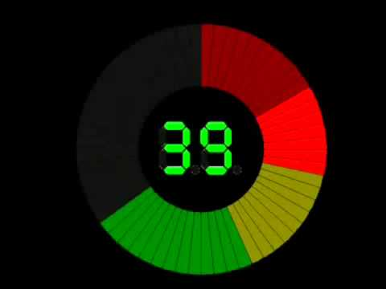
How many credits do you need to graduate?
How do we define college?
What is the difference between a community college and a university?
What is a certificate and where would a student earn one?
What are some other ways an individual could get trained for a career?
Write down two questions you have about transitioning out of high school.
POP QUIZ

Slide 3
Graduation Requirements
English: 4 credits
Social Studies: 3 credits
Mathematics: 4 credits
Science: 3 credits
Physical Education: .5 credit
Health: .5 credit
Computers: .5 credit
Senior Seminar/Financial Literacy: 1 credit
Visual, Performing, and Applied Arts: 1 credit
*World Language: 2 credits
Electives: 4.5 credits
Total: 24 credits
*One World Language credit may be substituted for an additional Visual or Performing Arts credit

Slide 4
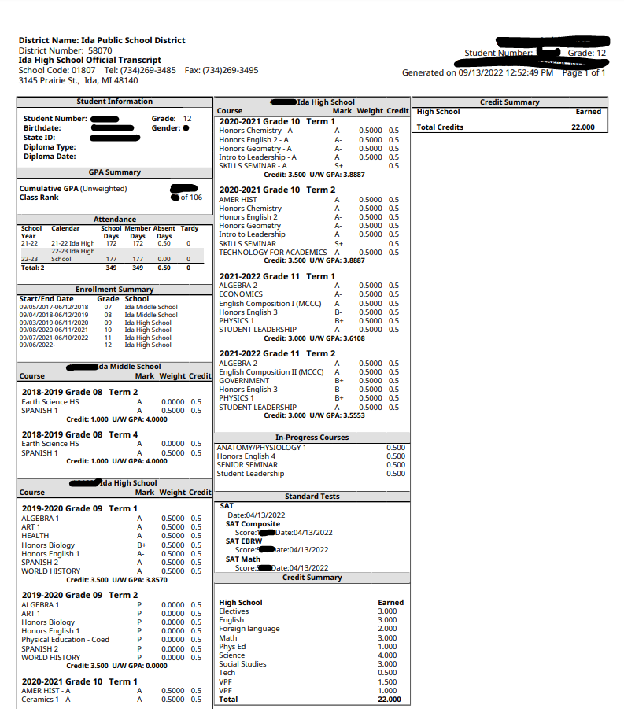
Transcripts
Unofficial Transcripts vs
Official Transcripts
Grad. Req.

Slide 5
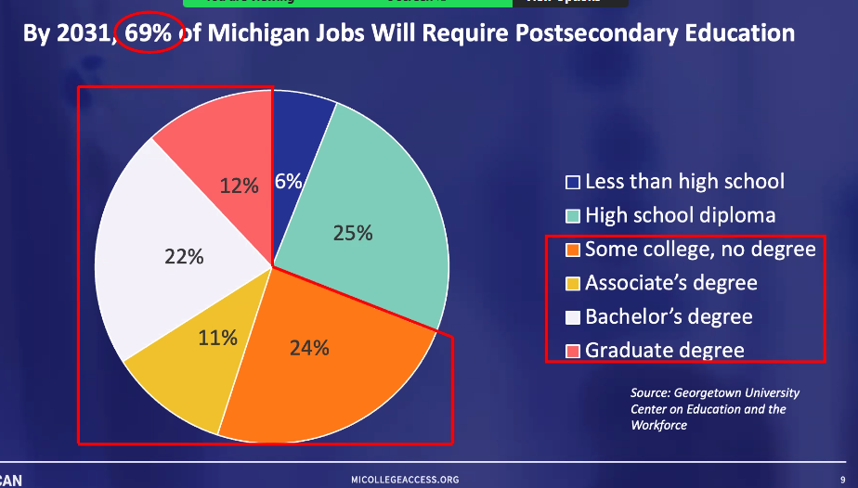

Slide 6
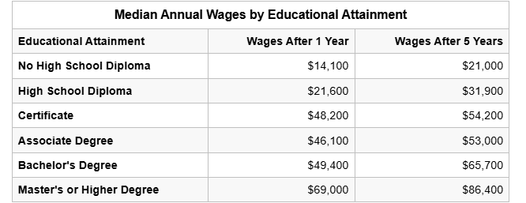
Emp. Rates

Slide 7

What’s next & how do I get there?

Slide 8
Military
Military
Skilled Trades
College
What are some of the benefits of joining the military?
Is the military a good option for you?

Slide 9






If you are interested in the military:
Meet with recruiters from 2 different branches
Take the ASVAB- Dec. 8th 1st-3rd hours @ IHS
Long Term Plan
Start Training
Military Links

Slide 10

Skilled Trades
What would be considered a skilled trade?
High Skill, High Pay, High Demand
Type of trainings
On the Job
College Classes
Apprenticeship/Union

Slide 11

Skilled Trades
Research Possible Careers & Programs
Consider Community College Opportunities
Community College Guarantee
MCCC Apprenticeship
SEMCA (semcaschool.org)
Take Advantage of Current Classes
Start Working
Upcoming Opportunities:
Just Build It: October 7th-Sign up TODAY!
Attend X Tech Open House on 10/21 at MCCC
Career Expo in the Spring

Slide 12
College & University
Plan
Research
Senior Year Timeline
12th Grade Checklist
Research Colleges
Michigan College Guide & MI Institution Updates
My Big Future & College Scorecard
Preview Colleges
College Contacts
College Visits, Preview Day & Virtual Tour Visit Checklist
Notes:
Website Update Copies
12th Checklist 12th Checklist
MI Public Universities
College Night at MCCC X

Slide 13
College & University
Apply
Apply, Apply, Apply
5 schools (2 Dreams Schools, 2 Safe Schools , 1 Backup School)
Michigan Assured Admissions Pact (Assured Admissions with 3.0 in 10 of MI Public Universities)
Application Day October 15th in your Sen Sem or Fin Lit class
College Seminars Tuesdays in the Library During Lunch
Application Fee Waivers & Free Applications in Oct for Michigan Schools
2025 IHS Application Info Sheet and Terms
Letters of Rec Form for Dr. Daniels Due October 7th
Notes:
Website Copies
IHS Application Info X

Slide 14
College & University
Apply
Common Application Common Application Guide
Early Decision Nov 1st (Plan ahead for official transcripts, SAT scores, & recommenders)
Send Official High School Transcripts
Mrs. Nowak (nowak@idaschools.org) or Parchment
Dual Enrollment MCCC Transcript Requests
SAT Scores SAT Scores
Register with NCAA and/or NAIA if applicable NCAA NAIA
Notes:
Website Copies

Slide 15
College & University
Apply
Test Scores
Test Optional or Test Flexible
Consider the University’s SAT/ACT Average
Consider IHS Average SAT Score (981)
Consider the University’s Scholarships
Notes:
Test flexible and Test optional
Standardized test scores are considered if the applicant decides to submit their SAT or ACT® scores as part of their application. It doesn’t mean that schools aren’t interested in seeing all applicants’ test scores—but if a student doesn’t submit their scores, it won’t be counted against them in the application review.
Test Blind and Test Ignored
Test Blind Standard test scores are not considered as a part of the application evaluation.
Test Ignored Standardized test scores are ignored if they are received

Slide 16
Paying for College
How much does college cost?
What are some ways you can pay for college?
BE A SMART CONSUMER!

Slide 17
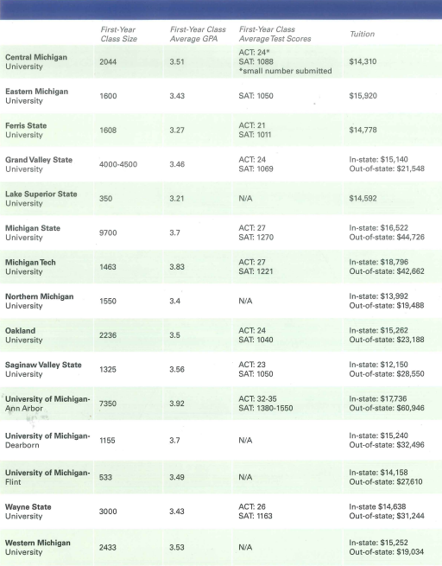

Slide 18
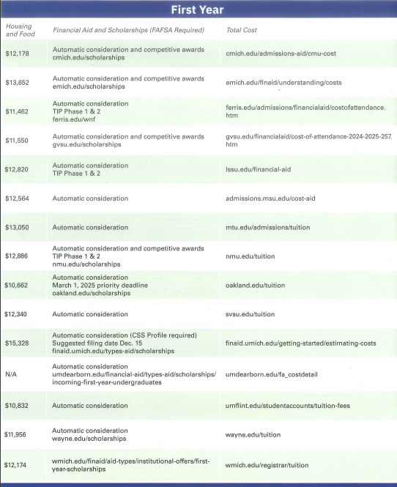
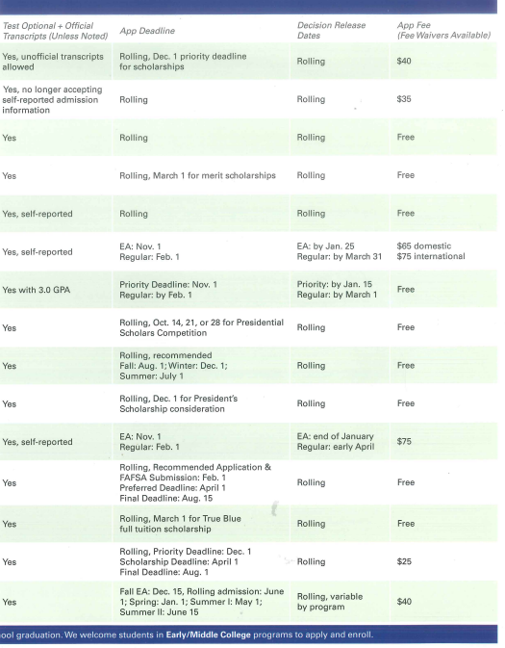

Slide 19
Types of Scholarships
College or Institutional Scholarships
Community
Ida Community Scholarships
State of Michigan Scholarships
Company/Organizations
National Scholarships

Slide 20
Institutional Scholarships
Merit Scholarships-offered during admissions and based on students GPA and/or SAT.
UT Merit EMU Merit CMU Merit
Presidential or Competitive Scholarships-often a full ride scholarship, very competitive, with early deadlines and require a visit.
UT MCCC EMU CMU
Institutional Scholarship Searches-an institutional scholarship database offer to students once admitted
UT MCCC EMU January-March (double check dates for individual institutions)

Slide 21

Types of Scholarships
Community
Ida Community Scholarships
State of Michigan
MI Student AID
Michigan Achievement Scholarship

Slide 22

Scholarship Search Sites
Company/Organizations
National Scholarships
www.goingmerry.com mybigfuture.com www.fastweb.com

Slide 23
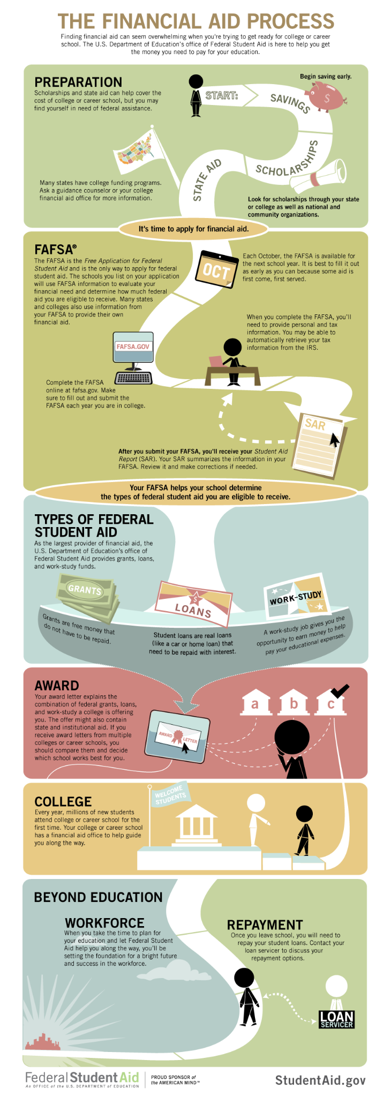
Paying for College
Four ways to pay for college
-Scholarships
-Loans
-Grants
-Work Study
FAFSA
-Free Application for Student Aid
-Opens October 1st 2024 for 2026-2027
school year
-Paying for College Night October 22nd

Slide 24
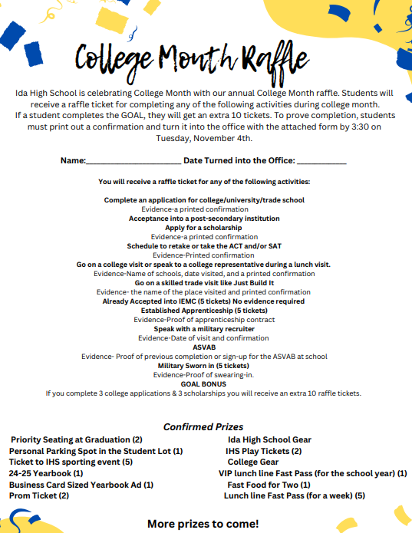
College Month
College Month Goals- to give every senior the opportunity, tools, and support to complete an application to start their post-secondary journey.
College Month Activities
College Month Raffle
College Month Survey

